Slide 1

Mitigating Hazards at the Different Levels (local, regional, globally)
Carina Lalyer
Presentation for course 816.343: Environmental Risk Analysis and Management
Vienna, 9.05.2023

Slide 2
Content
Mitigating hazards
Local mitigation
Regional mitigation
Global mitigation
Examples
Examples
Examples

Slide 3
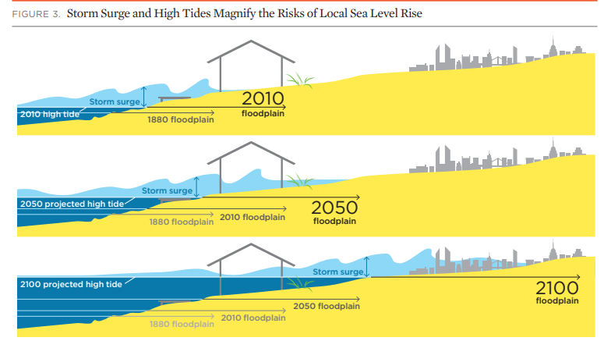
Mitigating hazards at the different levels: local, regional, global
Hazard: a threatening phenomenon that may cause social, economic or environmental destruction within a given period and area (EEA, 2017)
Location, intensity, frequency and probability (ISDR, 2009)
Climate change increases the severity, frequency and duration of climate-related disasters
Sea level rise 0-18-0.59 meters by 2100 and even up to 2 meters (Bosello and De Cian, 2014)
Image source: © APRIL 2013 union of concerned scientists
www.ucsusa.org/sealevelrisescience

Slide 4
Mitigation refers to measures that are aimed at reducing the potential damaging effects of natural hazards (ISDR, 2009) to human communities and ecosystems.
Climate change (CC), mitigation refers to limiting greenhouse gas (GHG) emissions
Adaptation is the adjustment of society or ecosystems in response to hazards to lessen their effects.

Slide 5
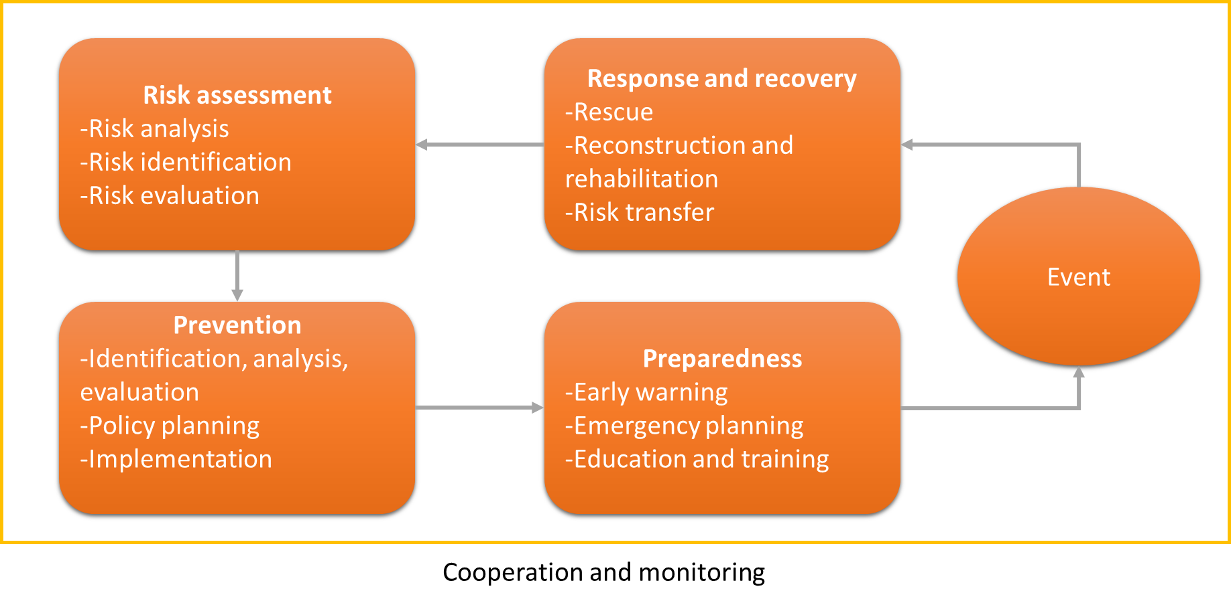
Disaster risk management
Mitigation of hazards is part of a larger framework called disaster risk management
Image: Disaster risk management cycle, adapted from (European Environment Agency, 2017)

Slide 6
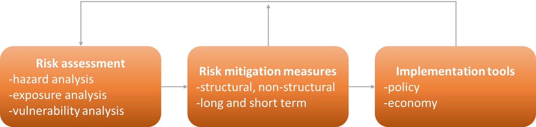
Components of risk mitigation
Mitigation measures often involve structural or non-structural measures
Long term and short term
Implementation tools that refer to transfers from policies to practical interventions and actions
Image: The different components in risk mitigation, adapted after (Esteban et al., 2011)

Slide 7
Mitigation: a complex feat
National government and organisations
Local government and organisations
Individual
Regional government and organisations
International organisations and bodies
Communication and coordination
Financial budget
Awareness and willingness

Slide 8
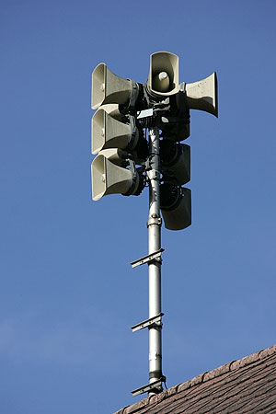
Communication
Communities that are less prepared for or aware of hazards will respond to an event in an ill-equipped manner, risking to sustain more sever and/or long lasting effects (Esteban et al., 2011).
Education and raising awareness
Warning systems, individuals will know what to do during an event
Image source: Creative Commons Attribution-Share Alike 3.0 Unported license. By Roland Zumbühl (Picswiss), Arlesheim (Commons:Picswiss project)

Slide 9
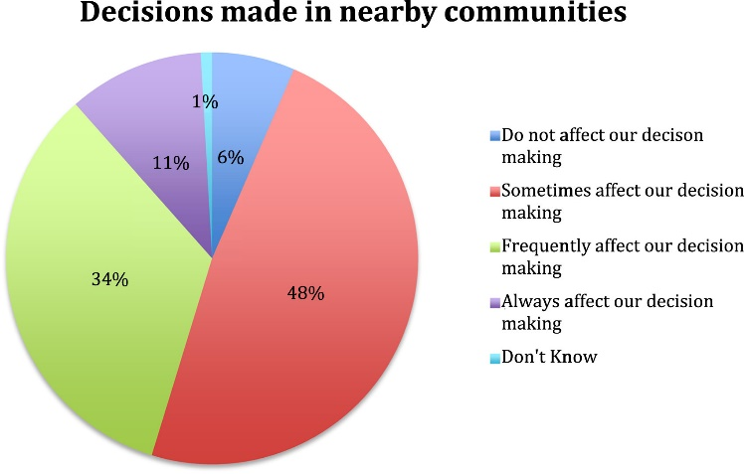
Coordination
Survey in New Zealand whether decision-making is affected locally by the decisions taken by near-by communities.
Image: Fig. 3. from Archie et al 2018
Respondent reports of the extent to which decisions in nearby communities affect their own decision-making (N = 249).

Slide 10
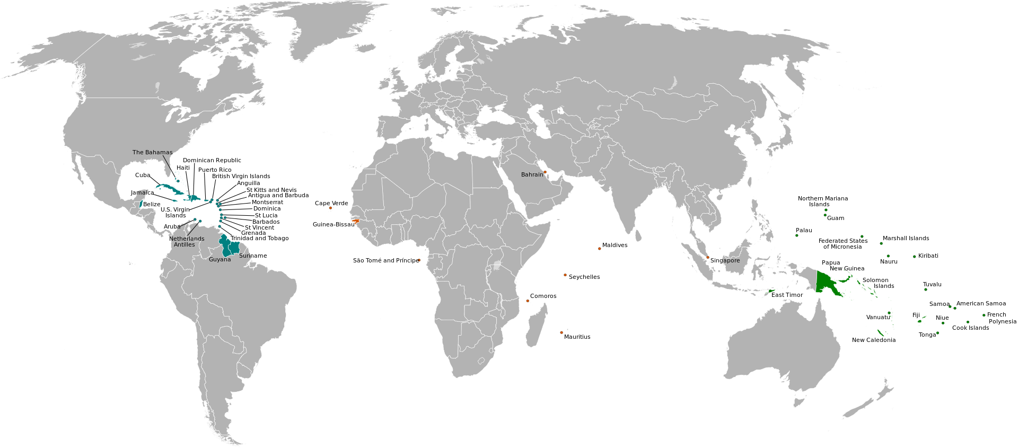
Local level mitigation
Small Island Developing States are a group of 58 states located in all oceans of the world
High vulnerability to climate change and in particular to the SLR hazard
Image By Osiris - Own work, CC BY-SA 3.0, https://commons.wikimedia.org/w/index.php?curid=23505603

Slide 11
Hazards
Economic impacts: land loss, increased coastal flooding, storms, coastal erosion, salinization of coastal aquifers, loss of homes, loss of livelihoods etc. (Martyr-Koller et al., 2021).
Non-economic hazards: disruption of cultural and social life, forced relocation, internal and international displacement, financial and political barriers. (Martyr-Koller et al., 2021)

Slide 12
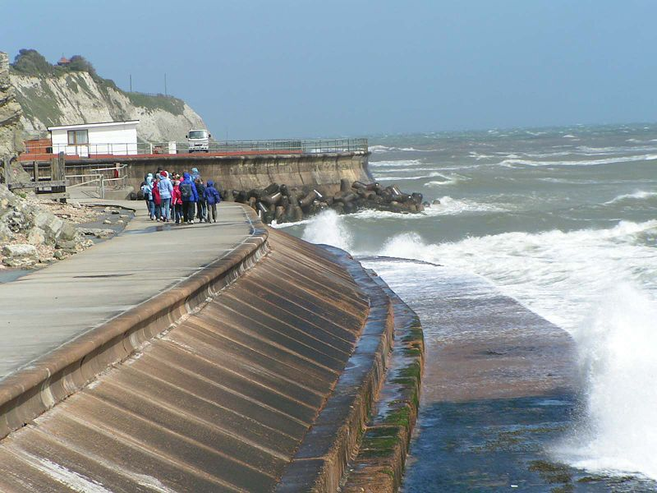
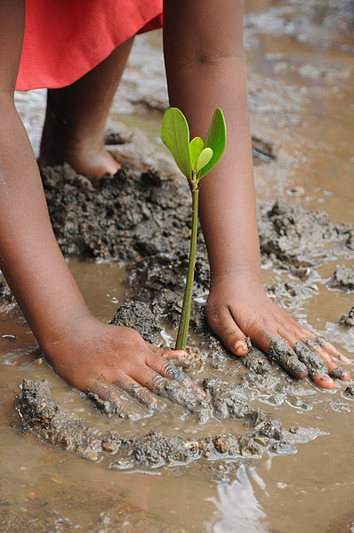
Local mitigation measures
Generally, all measures trigger trade-offs and co-benefits
Structural measures include engineering solutions like breakwaters, seawalls, elevated buildings or beach nourishment
Ecosystem-based solutions (EBS) are also taken into considerations such as coral reef or mangrove restauration
Image by Lizot pierrick, own work, Creative Commons Attribution-Share Alike 4.0 International
https://commons.wikimedia.org/wiki/File:Plantation_de_pal%C3%A9tuviers.jpg

Slide 13
Regional mitigation
The case of the EU
Responding to extreme events is the responsibility primarily of local governments (EEA, 2017)
But higher level governments have a role to support municipalities in the various stages of DRR (EEA, 2017)
Effective coordination and collaboration between the national and sub-national administrations (EEA, 2017)

Slide 14
EU civil protection mechanism
Image source: European Commission, 2020

Slide 15
Regional mitigation
The case of the EU
In 2009, the Council invited the Member States to develop national risk analyses, it recommended taking into account the future impact of climate change (European Commission, 2020)
The European Green Deal adopted by the Commission in December 2019
  a set of policy and legislative initiatives
  making Europe the first climate-neutral, climate-re­silient and environmentally sustainable continent over the next decades (European Commission, 2020)

Slide 16
Image source: European Commission, 2020

Slide 17
Shifting from regional to global
Disaster risk management in the EU is closely linked to global initiatives, in particular, the Sendai Framework for Disaster Risk Reduction
Reduce: global disaster mortality
    Number of affected people
    Economic loss in relation to GDP
    Damage to critical infrastructure and service disruption
Increase: Number of countries with national and local DRR strategies by 2020
    International cooperation to developing countries
    Availability and access to early warning systems and DRR information
Source: https://www.preventionweb.net/sendai-framework/sendai-framework-at-a-glance

Slide 18
Shifting from local to global
“SIDS at the forefront of global discussions on strong climate mitigation ambition, minimizing the risks from climate change, and on mechanisms to address loss and damage” (Martyr-Koller et al, 2021).
Warsaw International Mechanism for Loss and Damage
  assist developing countries that are particularly vulnerable to the adverse effects of climate change
Enhancing knowledge and understanding of comprehensive risk management approaches to address loss and damage
Strengthening dialogue, coordination, coherence and synergies among relevant stakeholders
Enhancing action and support, including finance, technology and capacity-building
Source: https://unfccc.int/topics/adaptation-and-resilience/workstreams/approaches-to-address-loss-and-damage-associated-with-climate-change-impacts-in-developing-countries#Action-and-support

Slide 19
Local, regional to global
The Paris Agreement
A legally binding international treaty
It entered into force on 4 November 2016
Today, 194 Parties (193 States plus the European Union)
Limit temperature rise to 1.5 °C
Reviews countries’ commitments to cutting emissions every 5 years
Provide climate finance to developing countries
Source: https://www.un.org/en/climatechange/paris-agreement

Slide 20
Summary
Mitigation refers to measures that are aimed at reducing the potential damaging effects of natural hazards (ISDR, 2009) to human communities and ecosystems.
  There are structural and non-structural measures
Hazards affect communities differently based on their vulnerability and resilience
Climate change increases the severity, frequency and duration of climate-related disasters, including sea level rise
Local-regional-global cooperation and coordination is crucial
Policy and economic instruments must be put into place

Slide 21
References
Archie, K.M., Chapman, R., Flood, S., 2018. Climate change response in New Zealand communities: Local scale adaptation and mitigation planning. Environmental Development 28, 19–31. https://doi.org/10.1016/j.envdev.2018.09.003
Bosello, F., De Cian, E., 2014. Climate change, sea level rise, and coastal disasters. A review of modeling practices. Energy Economics 46, 593–605. https://doi.org/10.1016/j.eneco.2013.09.002
Esteban, J.F., Izquierdo, B., Lopez, J., Molinari, D., Menoni, S., De Roo, A., Deeming, H., Walker, G., Eftichidis, G., 2011. Current Mitigation Practices in the EU, in: Menoni, Scira, Margottini, C. (Eds.), Inside Risk: A Strategy for Sustainable Risk Mitigation. Springer Milan, Milano, pp. 129–186. https://doi.org/10.1007/978-88-470-1842-6_4
European Commission. Directorate General for European Civil Protection and Humanitarian Aid Operations (ECHO)., 2021. Overview of natural and man-made disaster risks the European Union may face: 2020 edition. Publications Office, LU.
European Environment Agency., 2017. Climate change adaptation and disaster risk reduction in Europe: enhancing coherence of the knowledge base, policies and practices. Publications Office, LU.

Slide 22
References
ISDR, 2009. UNISDR Terminology on Disaster Risk Reduction. United Nations International Strategy for Disaster Reduction.
Martyr-Koller, R., Thomas, A., Schleussner, C.-F., Nauels, A., Lissner, T., 2021. Loss and damage implications of sea-level rise on Small Island Developing States. Current Opinion in Environmental Sustainability 50, 245–259. https://doi.org/10.1016/j.cosust.2021.05.001
Sendai Framework at a Glance. PreventionWeb.net. https://www.preventionweb.net/sendai-framework/sendai-framework-at-a-glance [Accessed 8.05.2023]
Approaches to address Loss and Damage associated with Climate Change impacts in developing countries. unfccc.int. https://unfccc.int/topics/adaptation-and-resilience/workstreams/approaches-to-address-loss-and-damage-associated-with-climate-change-impacts-in-developing-countries#Action-and-support. [Accessed 8.05.2023]
The Paris Agreement. un.org. https://www.un.org/en/climatechange/paris-agreement [Accessed 8.05.2023]

