Slide 1
Irrigation with treated wastewater and potential health risks
Presented by Nicola Stany
Source: https://www.insidescience.org/news/study a-treated-wastewater-detects-chemicals-drug-production-facilities

Slide 2
Table of contents
Introduction
Methodology
The use of TW in agriculture
Chosen examples in the frame of health risks
Research Questions
Conclusion

Slide 4
Introduction of treated wastewater
TW or reclaimed wastewater (RW) is sewage water that has been treated in multiple steps in order to have use for irrigation.
Most important alternative water resources in arid regions
Challenges related to the quality of treated wastewater, monitoring of irrigation practices, and potential exposure of people and the environment to pollutants.

Slide 5
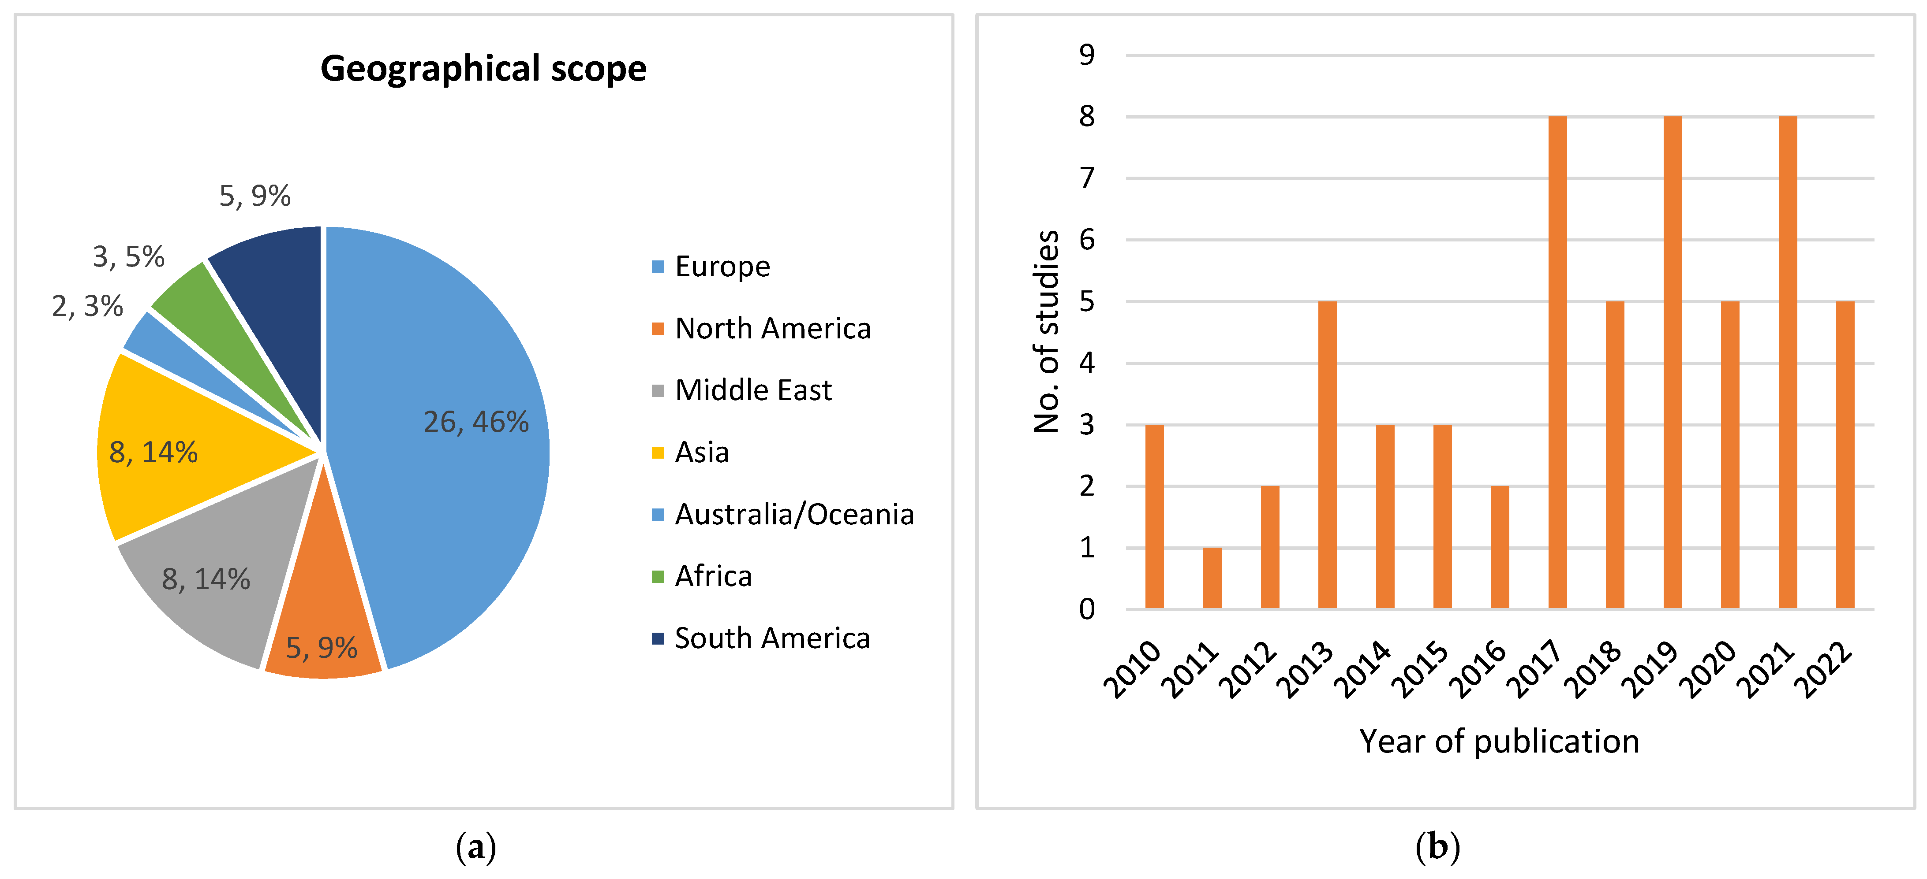
Methodology
Dense amount of papers and research in the area due to growing use of TW and research:
Figure 1: Geographical scope (a) and year of publication (b) of LCA studies on wastewater treatment and reuse including irrigation as a process or scenario (Mehmeti und Canaj 2022)

Slide 6
Why are studies on irrigation with treated wastewater (TW) and their possible impacts on health relevant?
What are examples of contaminating substances that are passed on via TW irrigation?
What can be done in order to prevent health risks of TW irrigation?

Slide 7
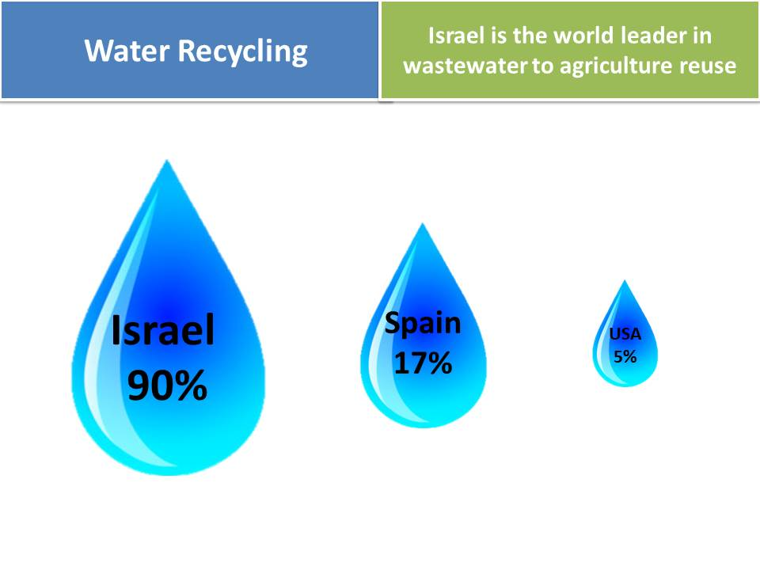
Agriculture is worldwide the largest
demanding sector of water
China: biggest producer and user of TWW
Austria:
Technically allowed (water permit)
but yet little use
Draughts require urban water management
Rising topic, also due to the new EU
Regulations on Water Reuse
(opt-out provision)
Presented by Nicola Stany
The regulatory framework is primarily governed by the Water Authority and the Ministry of Health of Israel
Scarcity of water, high investments in TWW systems
Source: https://www.ecoisraeltours.com/wastewater-to-agriculture-reuse/

Slide 8
Boron in laundry detergents
Slighly higher concentrations are damaging,
lethal to plants
Crop damage after years of TW irrigation
80-90% contamination due to detergents
New Israeli Standard (IS438) of boron in detergents since 1998

Slide 11
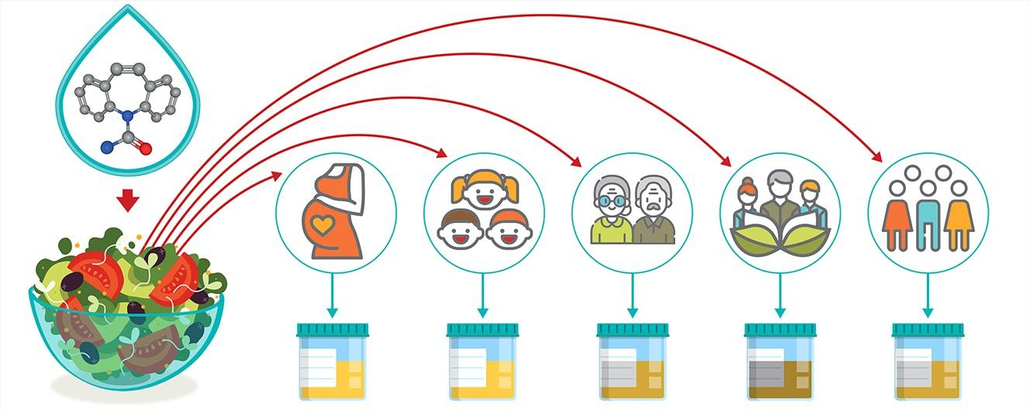
Involuntary exposure of Carbamazepine

Slide 12
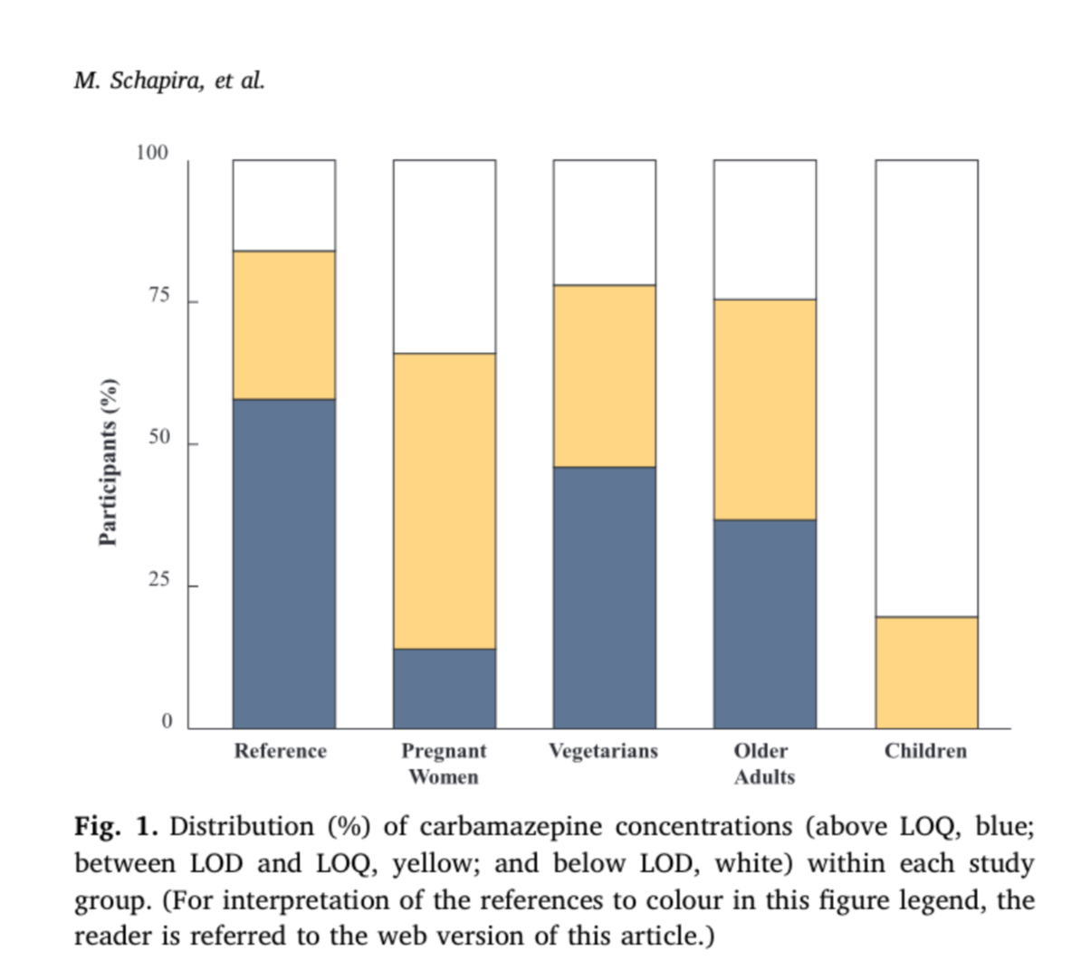
Mood stabilizer drug for epilepsy
Chemically stable in environment
Difficult to fully remove from TW
High detectable levels after studies
(245 volunteers, 75% of adults,
20% Children detectable levels LOD)

Slide 14
Benny Chefetz, Professor at Hebrew University Jerusalem: https://www.ehf.org.il/sites/default/files/Chefetz_EHF_Annual_Conf_2018.pdf

Slide 20
Conclusion of the paper
TW irrigation has emerged as a promising solution
Comprehensive health risk assessment needed
Ientifying potential contaminants, assessing exposure pathways, estimating toxicological effects, and implementing appropriate mitigation measures.
More research on environmental stability of drugs and chemicals

Slide 21
Thank you very much for your attention
I hope you found it interesting and heard smth new

