Slide 1
Drought Risk Assessment
Quantifying the Impacts of Droughts
LVA 816343 Environmental risk analysis and management
Tamara Graf 12247219
Johannes Herzog 11840221

Slide 2
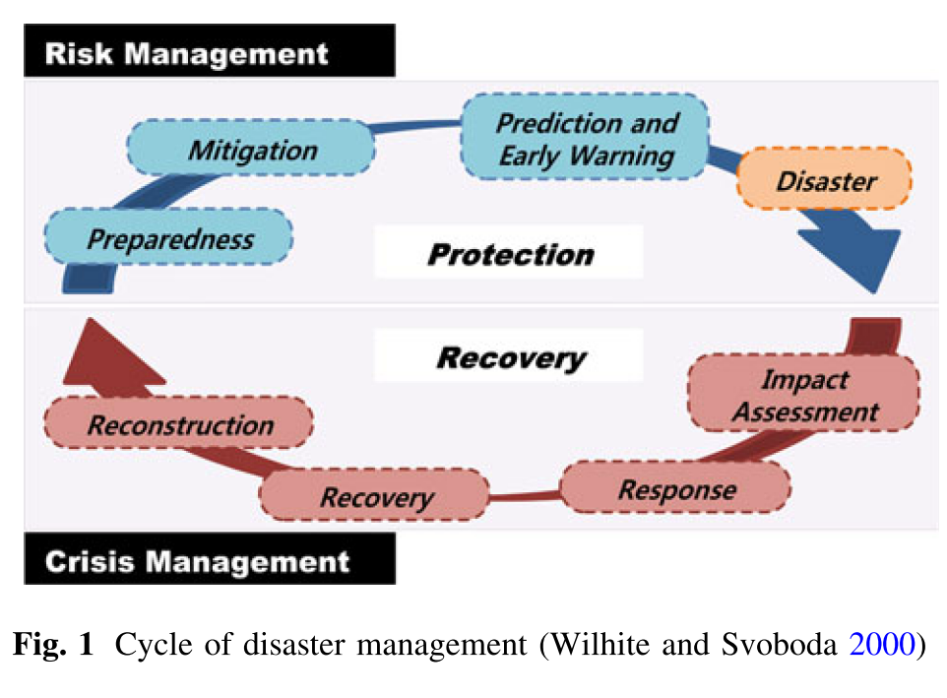
Definition of drought
= hazard that might damage environment, sociology or economy by temporary imbalance of water availability
Have different origins
Lead to various consequences
Difference to other hazards: drought does not occur abruptly
From "crisis management" to proactive "risk management"
(Nam et al. 2012)

Slide 3
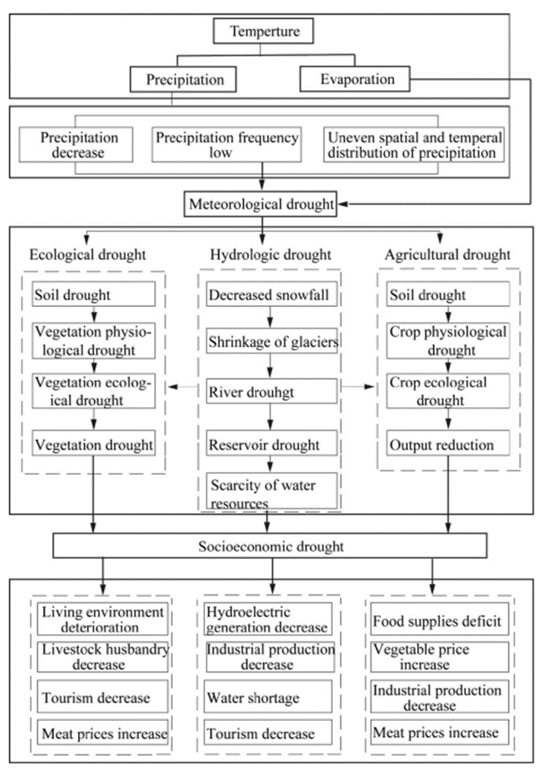
Drought categories
based on their causes and consequences
categories may differ with modelling type
connections and dependencies between different drought categories
Categories:
Meteorological drought
Standardised Precipitation Index (SPI)
Vegetation drought
Soil infiltration data
Hydrological drought:
surface water and ground water flows
(Zhang et al. 2016)​

Slide 4
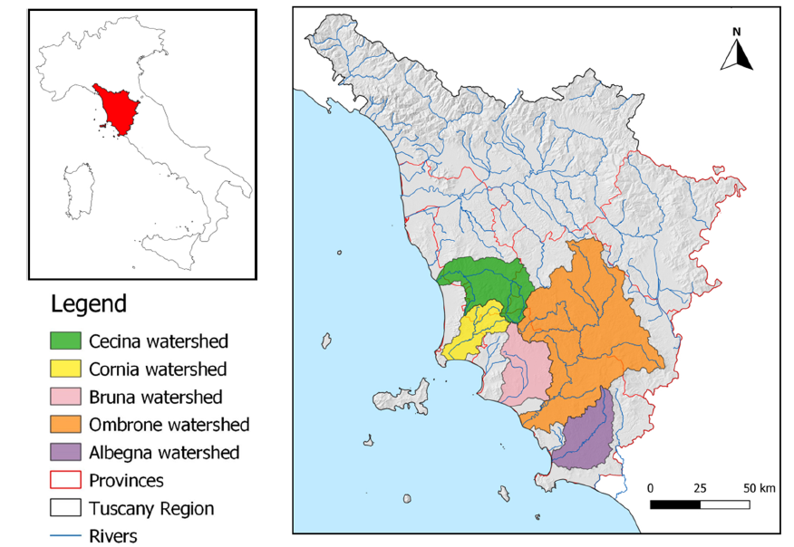
Drought risk in Mediterranean agricultural watersheds (1)
Italian Peninsula: expected rise in frequency and intensity of drought events
5 coastal watersheds in central and southern Tuscany
Methodology inspired by operational steps of OECD
Conceptual framework
Study area
Identification of indicators
Data acquisition and pre-processing
Multicollinearity analysis
Normalization and weighted aggregation
Robustness evaluation
Archetype analysis
(Villani et al. 2022)
Notes:
During the 4th step: Data acquisition and pre-processing, the selected indicators are transformed from absolute to relative values. By that, comparison between different locations within the study area is possible.
weighting method guarantee normalized values of the indicators for calculation of indices.
robustness of the created model needs to be tested. In the case study of Villani et al., this was done by considering internal and external validations.

Slide 5
Drought risk in Mediterranean agricultural watersheds (2)
Preparation and mitigation costs lower than potential damage
Selection of indicators
Establishment of Drought Risk Index (DRI)
Drought Hazard Index (DHI)
Drought Exposure Index (DEI)
Drought Vulnerability Index (DVI)
Facilitation of indicators
Assessment of multicollinearities
Archetype analysis
Notes:
facilitation = assessment of multicollinearities then is assuring the relevancy and eligibility of every indicator.
The archetype analysis = final simplification and interpretation of the indicators
here: output of that step was a hierarchical cluster analysis showing the recurrent patterns of drought indicators within the selected municipalities

Slide 6
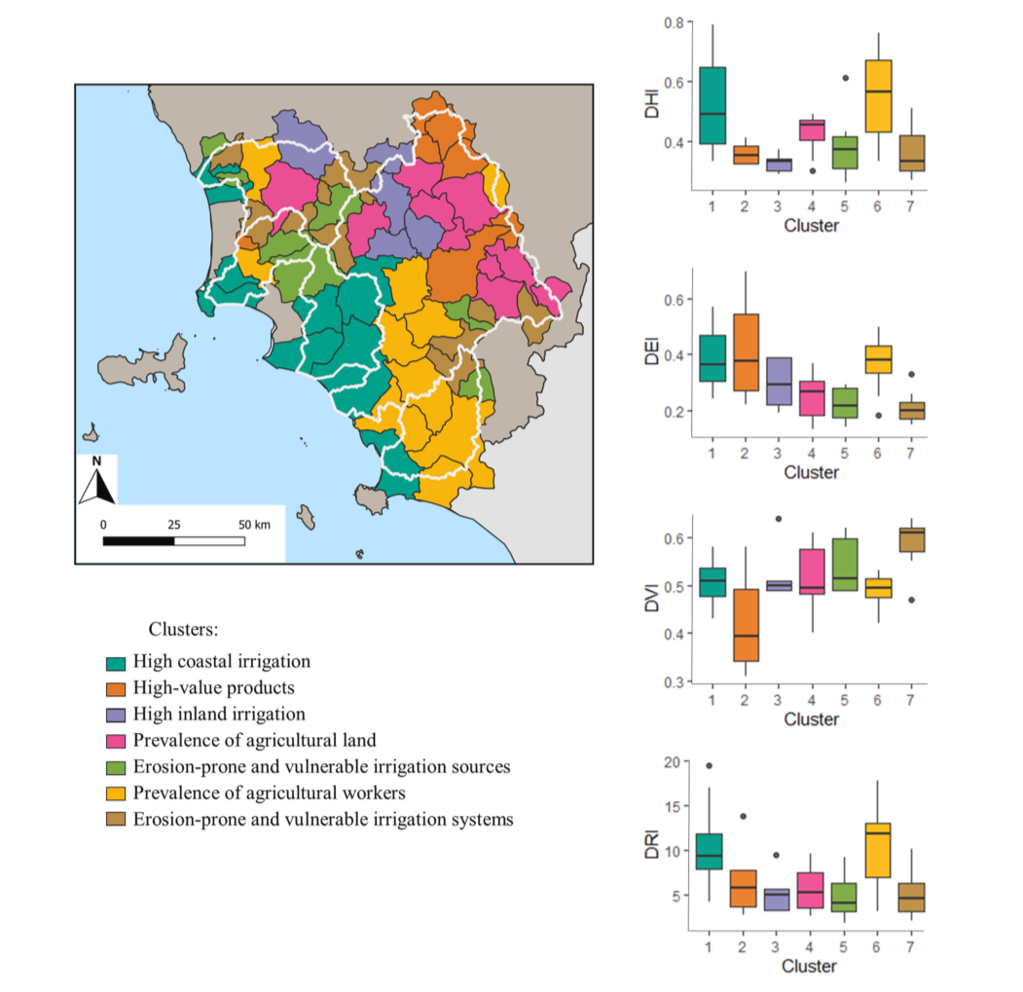
Spatial visualization of the
clusters identified in the
Tuscany region
(Villani et al. 2022)
Notes:
The boxplots coloured according to different clusters and the y – Axis shows the distribution of different indices. As seen in the figure, the width of the boxplots representing various clusters changes with the indices

Slide 7
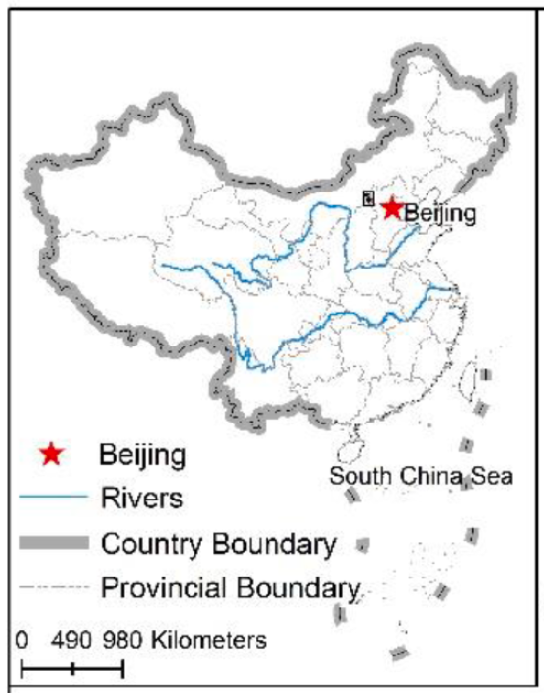
Drought risk for farmers in China (1)
Xinghe County (Northern China)
Semi-arid agricultural area → unstable precipitation
Three categories of data:
Environmental and geographic element data
Regional statistical data
Survey data (multi – stage random sampling method)
(Guo et al. 2022)
Notes:
Survey:
68 administrative villages surveyed
10 farm households
551 valid farm questionnaires collected

Slide 8
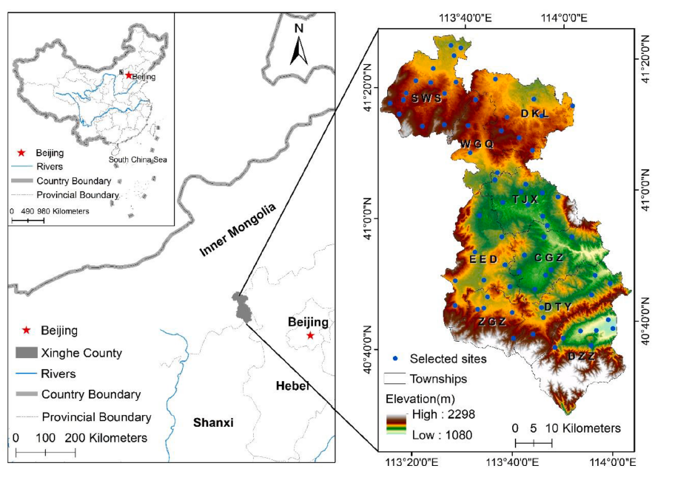
Distribution of survey sites
(Guo et al. 2022)
Notes:
21.4% of Xinghe County is arable
More than 90% of arable land is dry land
agricultural and pastoral zone of northern China
farmers have long tradition of raising livestock
still dominated by agricultural planting, mainly potatoes, miscellaneous grains, and beans

Slide 9
Drought risk for farmers in China (2)
focus on vulnerability of farmers
Not only objective but subjective indicators
disaster caused by drought:
drought adaptability of farmers:
Notes:
H = disaster caused by a drought:
ld (light) ; md (medium); sd (severe); ed (extreme) = severity of the drought and ω₁ – ω₄ = weights for grades of drought intensity from 0,1 – 0,4.
AD = Drought adaptability of farmers
µ₁ and µ₂ are the weights for various adaptability dimensions;
oa/sa stand for (objective -/subjective adaptability) and Ec (economic), So (social), Hu (human), Ma (material) are components of the objective adaptability evaluation
Pbd, Rdd and Rad represent the response consciousness of farmers before, during and after the disaster subjective adaptability evaluation.

Slide 10
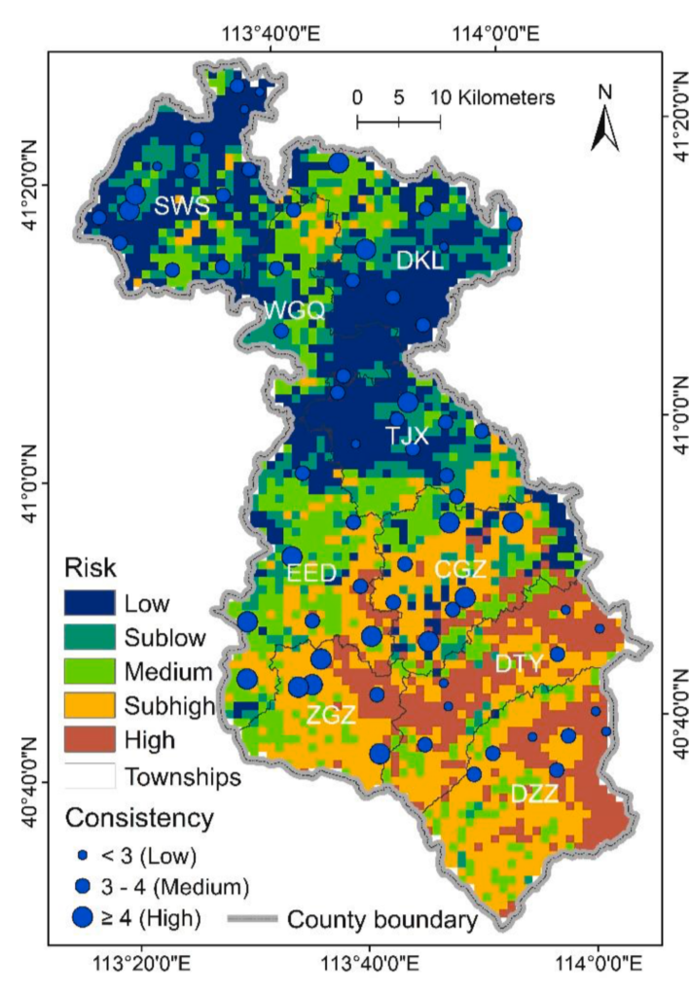
Drought risk assessment and consistency with farmers' drought loss (Guo et al. 2022)
Notes:
The figure below illustrates the drought risk assessment and consistency with farmers’ drought loss in the study area

Slide 11
Discussion
diversity and uncertainties in all levels of capturing drought risk
complexity of drought → complex modeling tools
High demand of resources for detailed modeling → disparities in quality of drought analysis
difficult to connect management plans between countries

Slide 12
References
Cutter, Susann (1993): Living with risk: The Geography of Technological Hazards. In: E. Arnold, Routledge, Chapman and Hall. ISBN: 0470249773, 9780470249772
Gabiña, Dunixi; Iglesias, Ana; Moneo, Marta (2004): Presentation of MEDROPLAN in Brussels. Online verfügbar unter http://www.emwis.org/initiatives/medaeau/fol719001/fol033012/MEDROPLAN_Brussels_June2004.pdf, zuletzt geprüft am 27.04.2023.
Guo, Hao; Wen, Xiaolan; Wu, Yaoyao; Wang, Jing'ai; Liang, Qin'ou (2022): Drought risk assessment of farmers considering their planting behaviors and awareness: A case study of a County from China. In: Ecological Indicators 137, S. 108728. DOI: 10.1016/j.ecolind.2022.108728.
Minucci, Guido (2021): Enabling Adaptive Water Management to Face Drought Risk in a Changing Climate. In: Springer International Publishing. DOI: 10.1007/978-3-030-55137-7
Nam, Won-Ho; Choi, Jin-Yong; Yoo, Seung-Hwan; Jang, Min-Won (2012): A decision support system for agricultural drought management using risk assessment. In: Paddy Water Environ 10 (3), S. 197–207. DOI: 10.1007/s10333-012-0329-z.
Organisation for Economic Co-operation and Development (OECD) (2021): Managing Climate Risks, Facing up to Losses and Damages. In: OECD Publishing. DOI: 10.1787/55ea1cc9-en.
Tsakiris, George (2017): Drought Risk Assessment and Management. In: Water Resour Manage 31 (10), S. 3083–3095. DOI: 10.1007/s11269-017-1698-2.
Villani, Lorenzo; Castelli, Giulio; Piemontese, Luigi; Penna, Daniele; Bresci, Elena (2022): Drought risk assessment in Mediterranean agricultural watersheds: A case study in Central Italy. In: Agricultural Water Management 271, S. 107748. DOI: 10.1016/j.agwat.2022.107748.
Zhang, Qiang; Han, Lanying; Jia, Jianying; Song, Lingling; Wang, Jinsong (2016): Management of drought risk under global warming. In: Theor Appl Climatol 125 (1-2), S. 187–196. DOI: 10.1007/s00704-015-1503-1.

Slide 13
Thank you for your attention!

